Slide 1

Създаване на приложения на една страница (SPA) с jQuery AJAX, REST и Kinvey
AJAX
REST
Kinvey

Slide 2
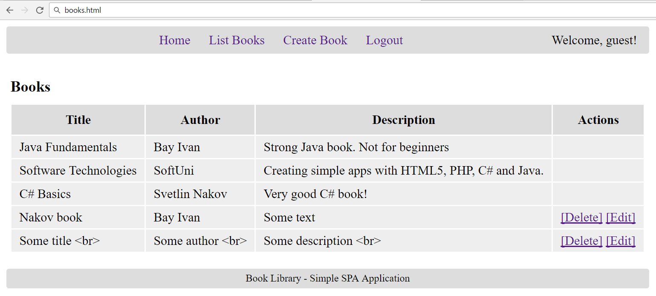
The Book Library Project

Slide 3
The "Book Library" App
Проектирайте и създайте приложение за библиотека от една страница (SPA) в HTML5 с REST back-end в Kinvey
Книгите трябва да имат заглавие, автор и описание (title, author and description)
Внедрете следните функционалности :
Вход, регистрация, изход, всички книги, създаване нова книга, редактирайте съществуваща, изтриване
Всеки може да разгледа всички книги
Само създателят на книгата може да редактира / изтрива собствените си книги

Slide 4
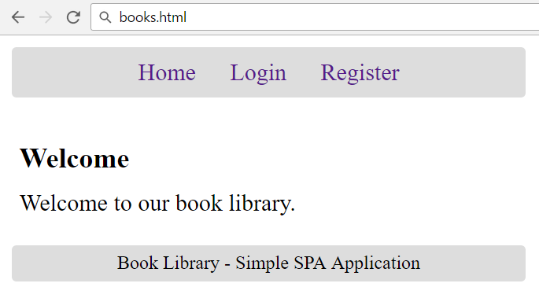
Началния екран

Slide 5
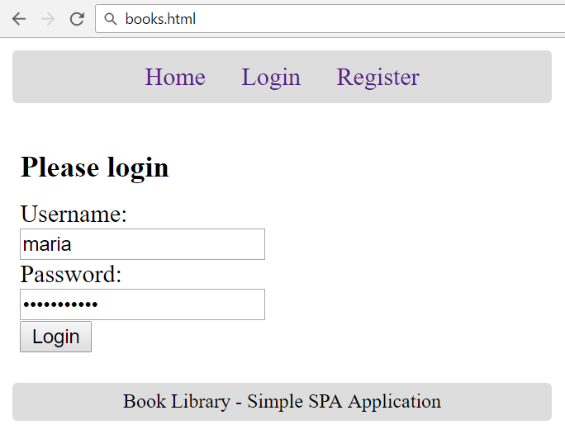
Екран за вход

Slide 6
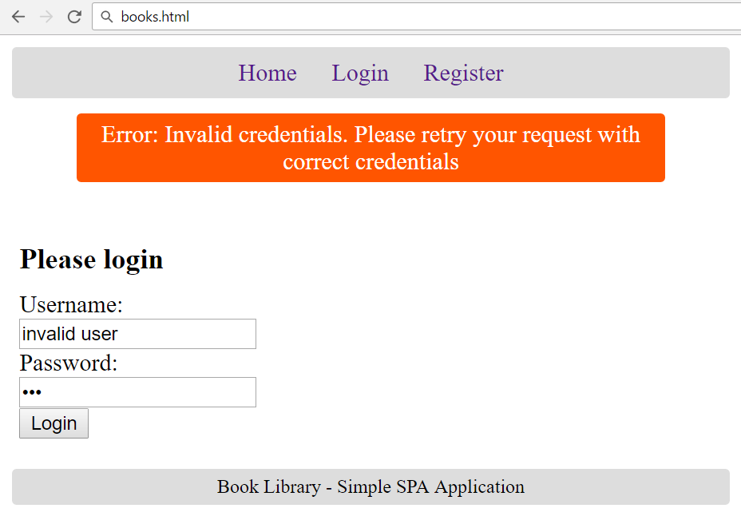
Екран за вход: Невалидно влизане

Slide 7
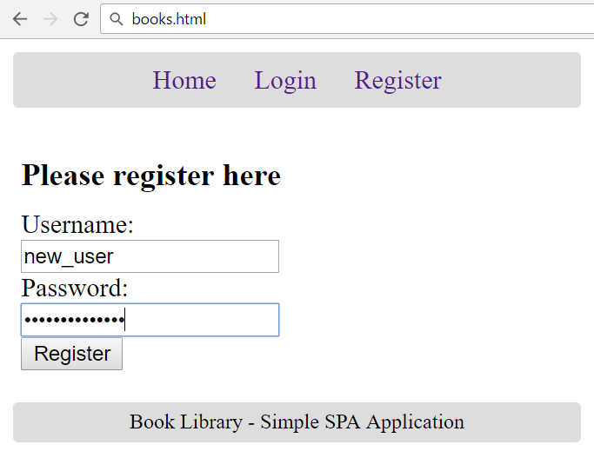
Екран за регистрация

Slide 8
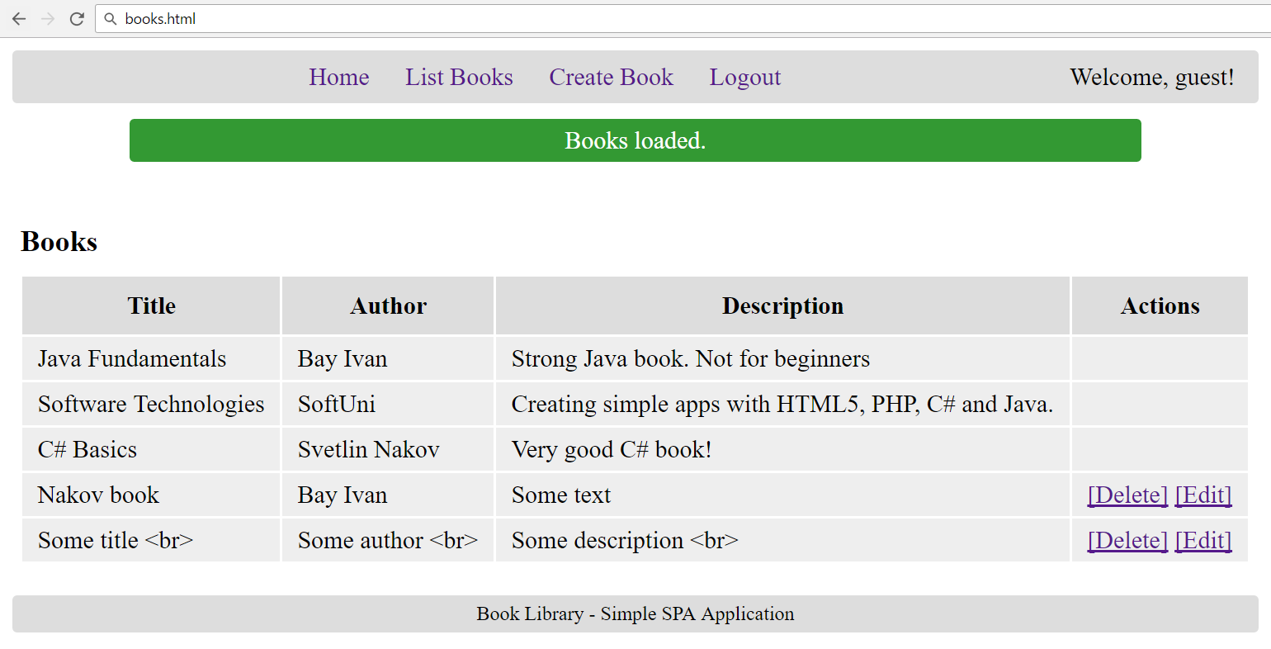
Екран на списъка с книги

Slide 9
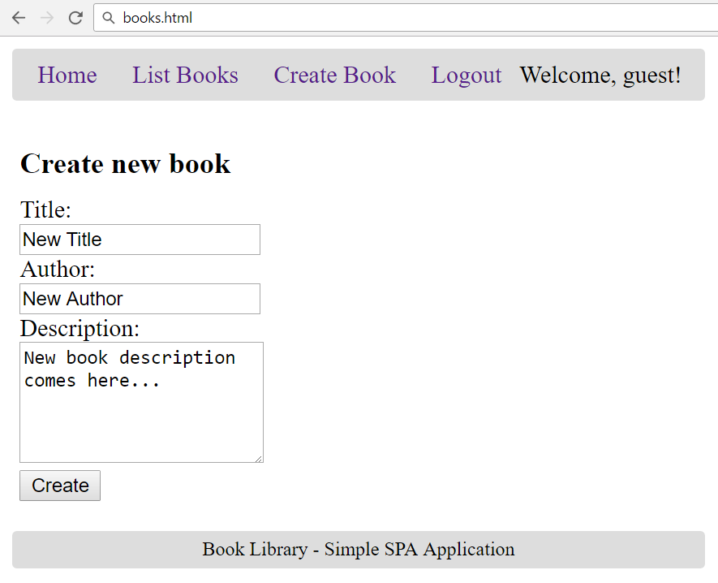
Екран за създаване на книга

Slide 10
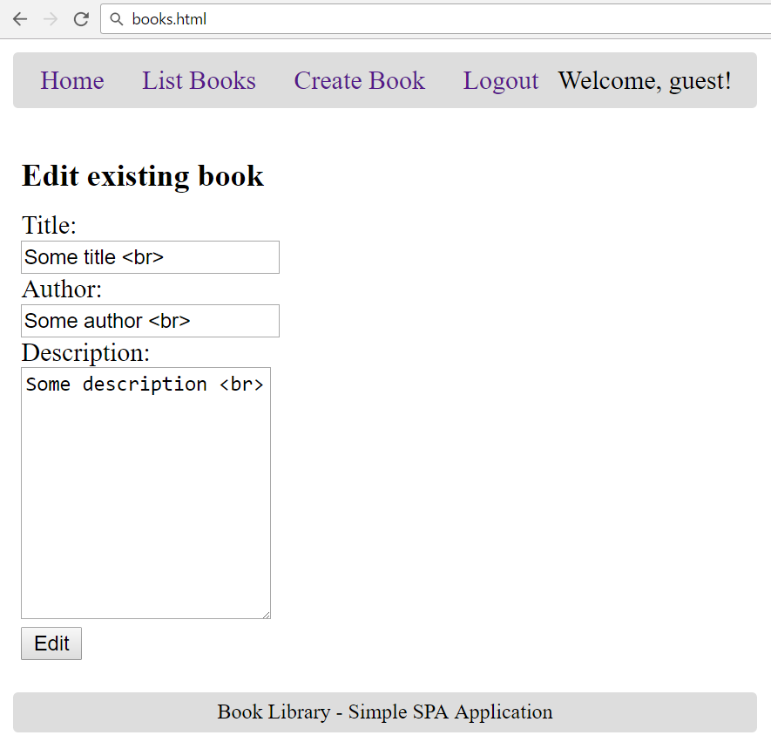
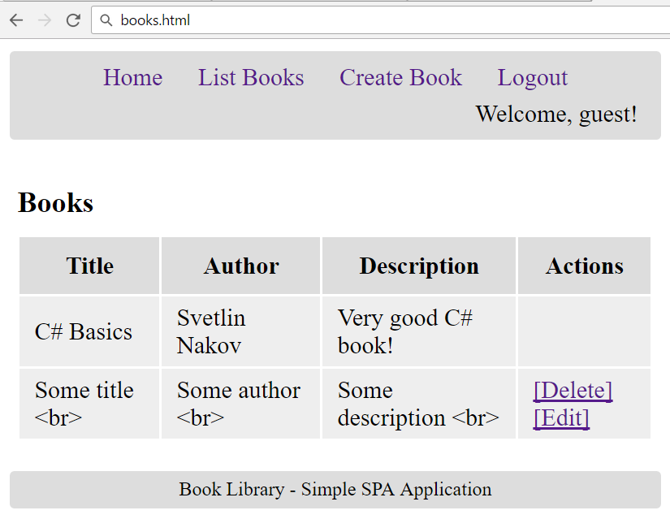
Екран за редактиране на книга

Slide 11
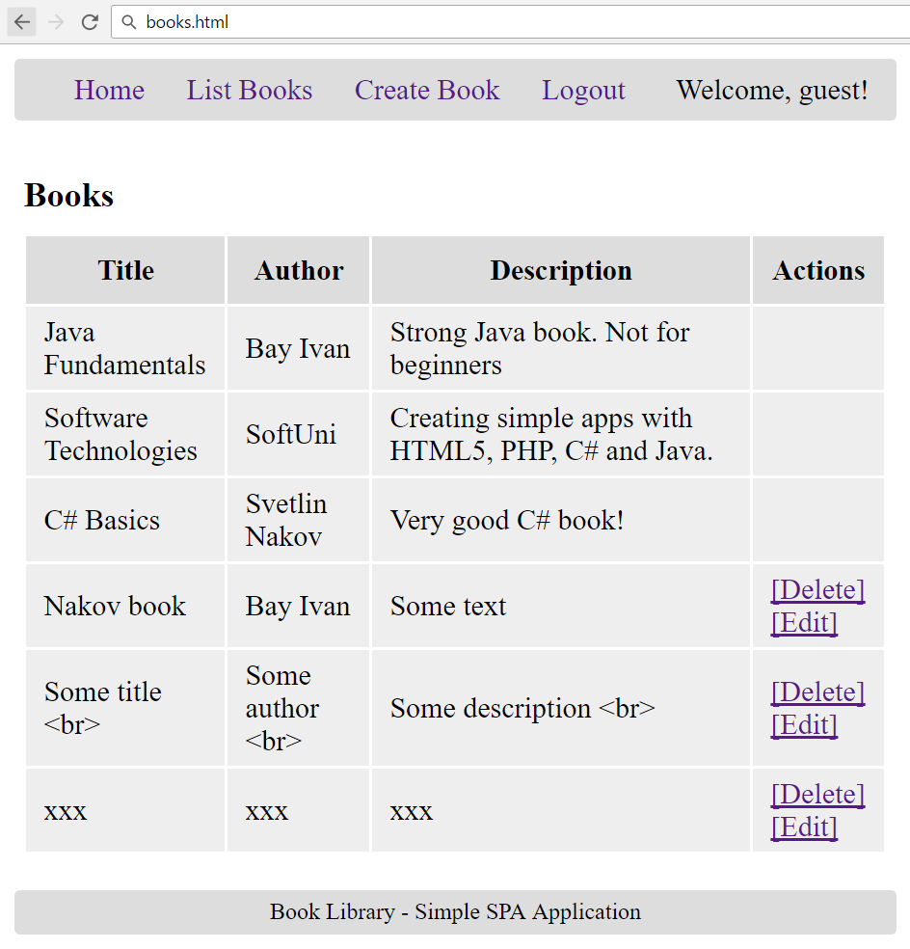
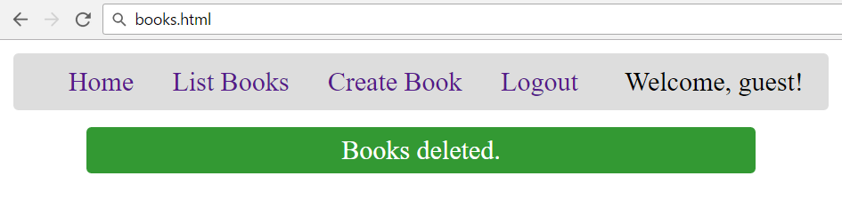
Екран за изтриване на книга

Slide 12
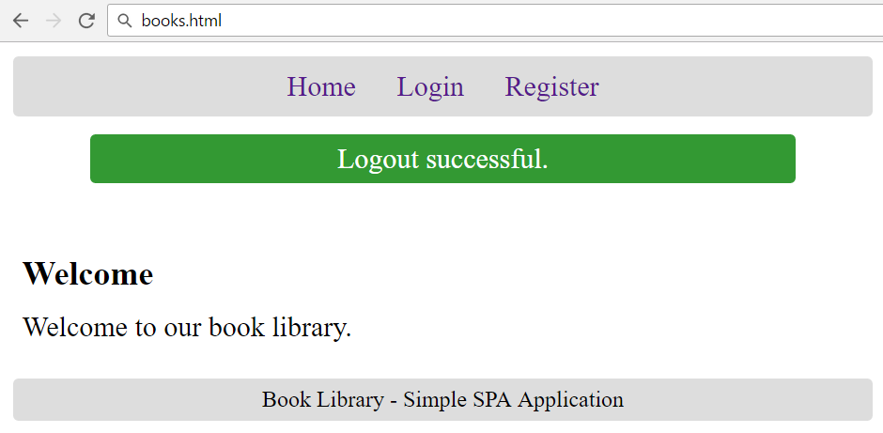
Екран за излизане

Slide 13
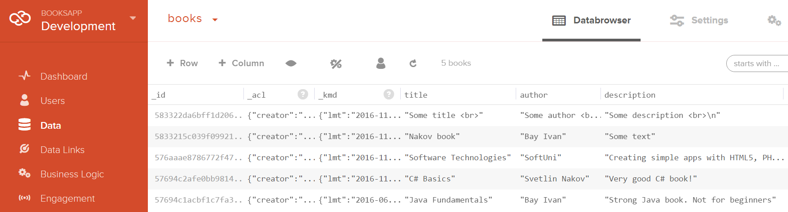
The Kinvey-Based Back-End
Users and Books Collections

Slide 14
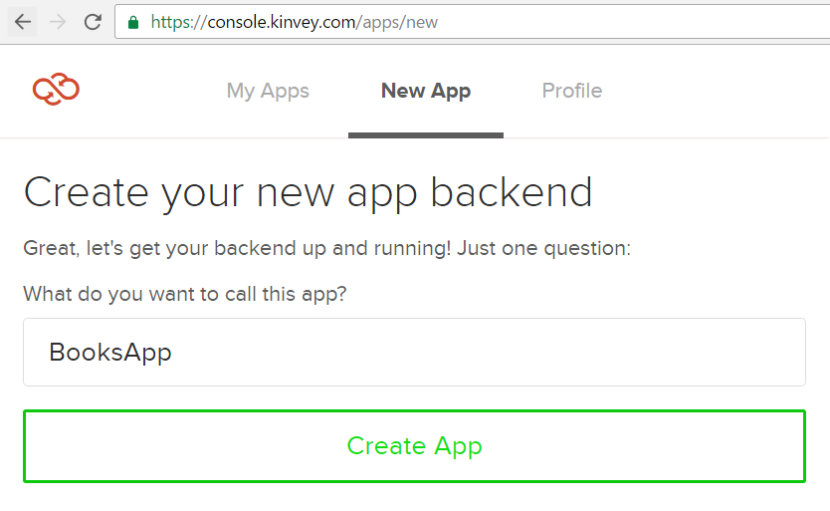
Създай Kinvey App
Как да създадеш профил, може да видиш тук .

Slide 15
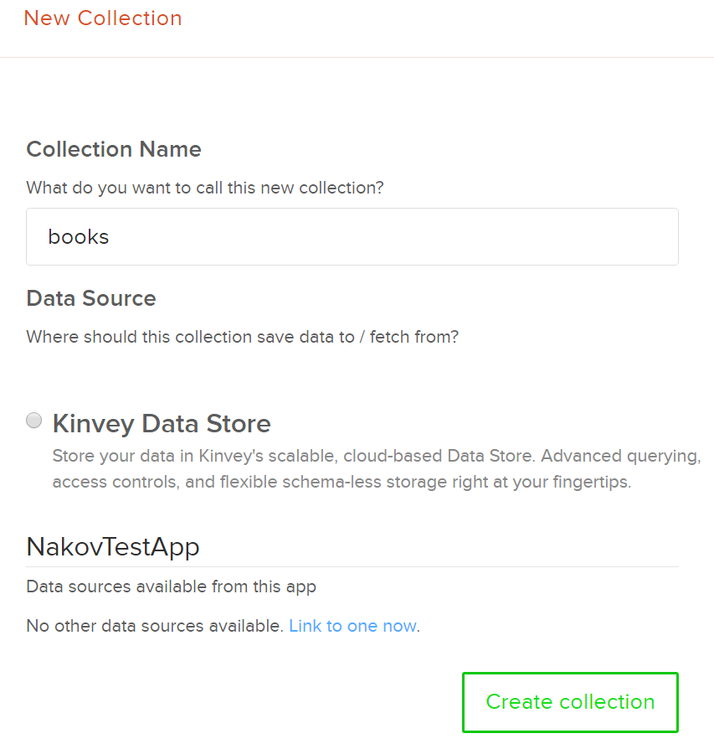
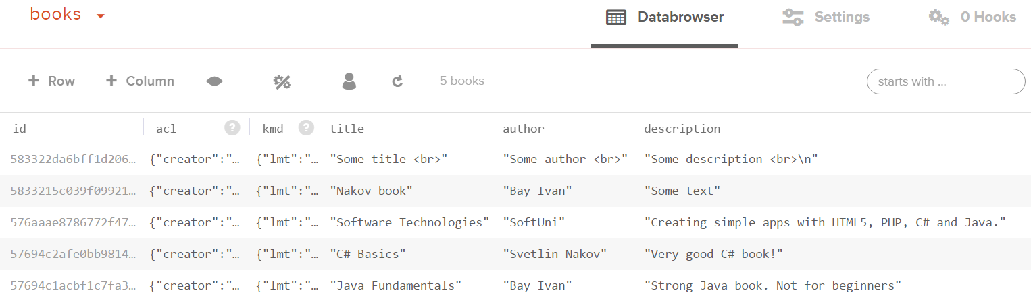
Създай колекция Books
Create a collection "books"
Add a few books
Колони: title + author + description

Slide 16
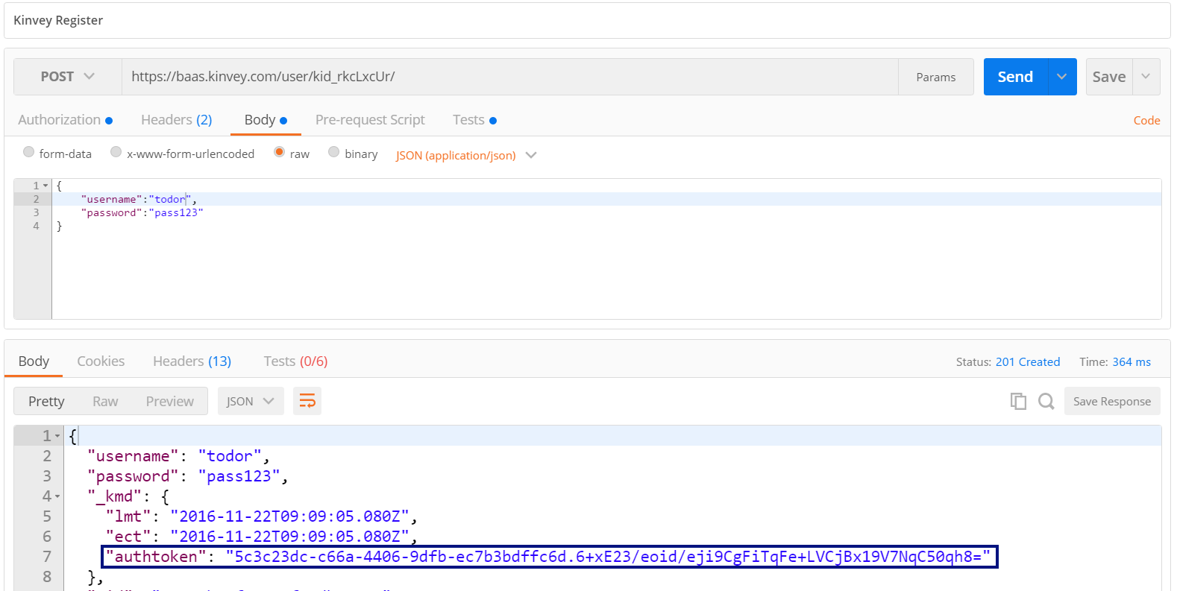
Тествай Kinvey Back-End: Създаване на потребител
POST
https://baas.kinvey.com/user/{app_id}/
Authorization: Basic base64(app_id:app_secret)
{"username":"todor", "password":"pass123"}

Slide 17
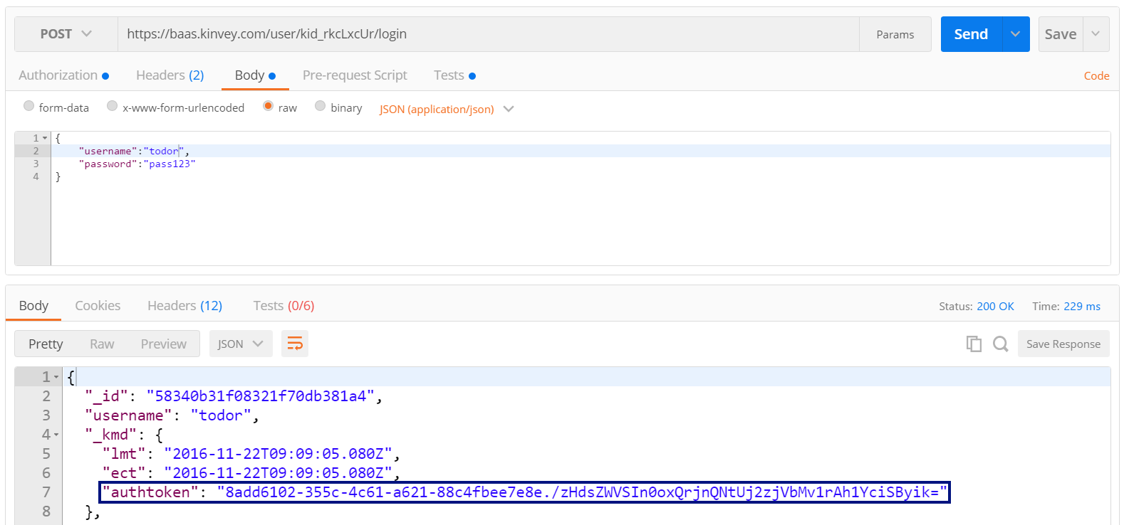
Вход на потребител
POST
https://baas.kinvey.com/user/{app_id}/login
Authorization: Basic base64(app_id:app_secret)
{"username":"todor", "password":"pass123"}

Slide 18
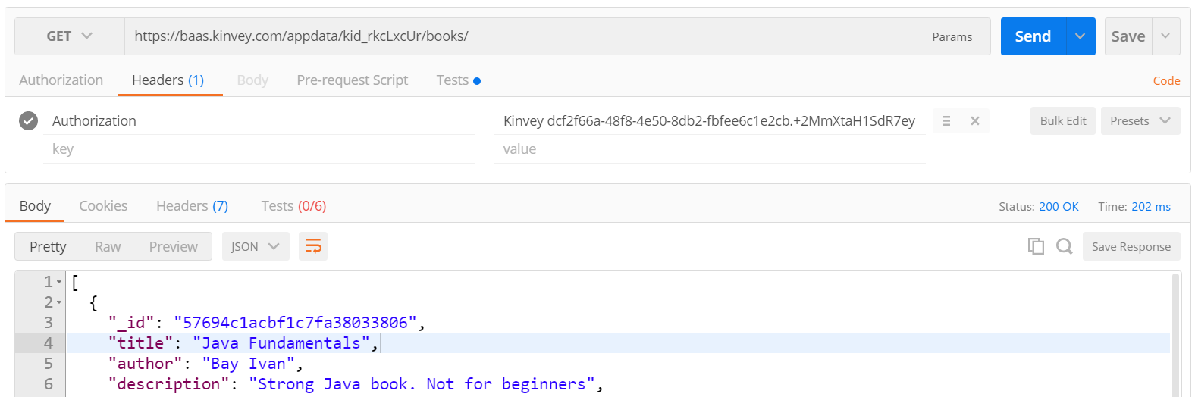
Списък на всички книги
GET
https://baas.kinvey.com/appdata/{app_id}/books
Authorization: Kinvey authtoken

Slide 19
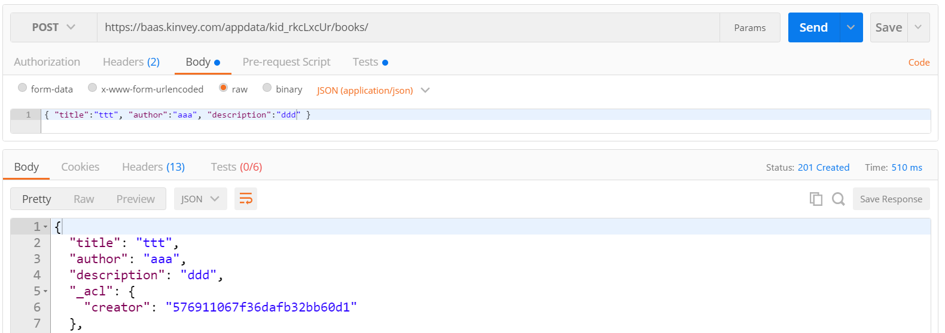
Създай нова книга
POST
https://baas.kinvey.com/appdata/{app_id}/books
Authorization: Kinvey authtoken
{ "title":"ttt", "author":"aaa", "description":"ddd" }

Slide 20
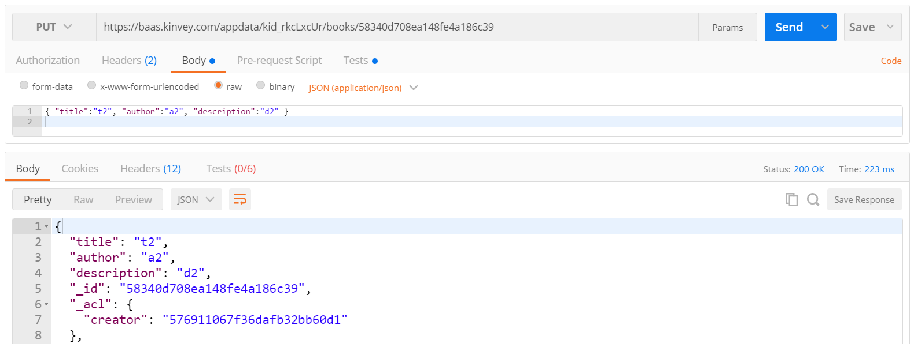
Test the Kinvey Back-End: Edit Book
PUT
https://baas.kinvey.com/appdata/{app_id}/books/{id}
Authorization: Kinvey authtoken
{ "title":"t2", "author":"a2", "description":"d2" }

Slide 21
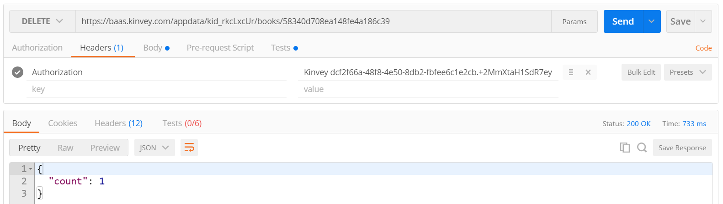
Test the Kinvey Back-End: Delete Book
DELETE
https://baas.kinvey.com/appdata/{app_id}/books/{id}
Authorization: Kinvey authtoken

Slide 22
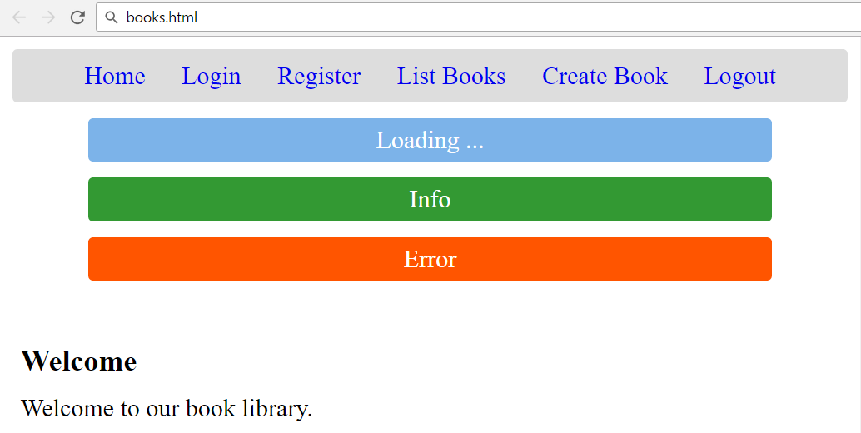
Create the Application Skeleton
HTML, CSS, Views, Forms, Info Boxes

Slide 23
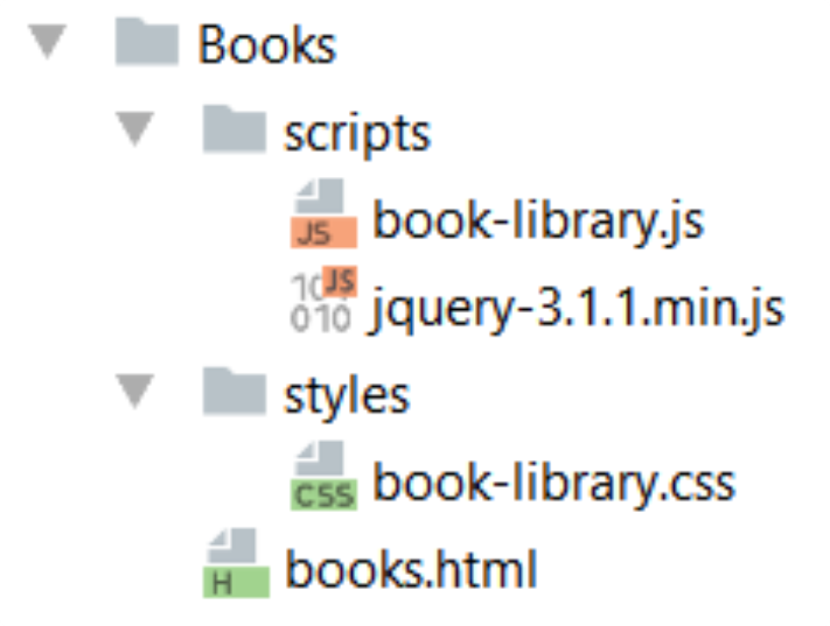
Create the Project Structure

Slide 24
Start with the HTML Page: books.html
<!DOCTYPE html>
<html>
<head>
<title>Book Library</title>
<script src="scripts/jquery-3.1.1.min.js"></script>
<script src="scripts/book-library.js"></script>
<link rel="stylesheet" type="text/css"
href="styles/book-library.css" />
</head>
<body>…</body>
</html>

Slide 25
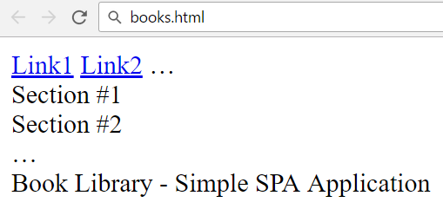
HTML Body Structure
<body onload="startApp()">
<header id="menu">
<a href="#" id="link1">Link1</a>
<a href="#" id="link2">Link2</a>
…
</header>
<main>
<section id="view1">Section #1</section>
<section id="view2">Section #2</section>
…
</main>
<footer>Book Library - Simple SPA Application</footer>
</body>

Slide 26
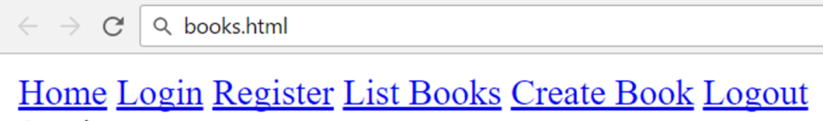
Main Navigation (Menu)
<header id="menu">
<a href="#" id="linkHome">Home</a>
<a href="#" id="linkLogin">Login</a>
<a href="#" id="linkRegister">Register</a>
<a href="#" id="linkListBooks">List Books</a>
<a href="#" id="linkCreateBook">Create Book</a>
<a href="#" id="linkLogout">Logout</a>
<span id="loggedInUser"></span>
</header>

Slide 27
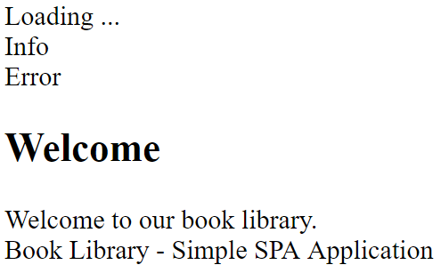
App Sections
<section id="loadingBox">Loading ...</section>
<section id="infoBox">Info</section>
<section id="errorBox">Error</section>
<section id="viewHome">
<h1>Welcome</h1>
Welcome to our book library.
</section>

Slide 28
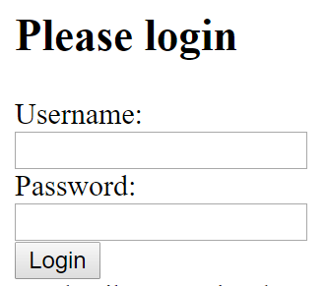
Login View
<section id="viewLogin">
<h1>Please login</h1>
<form id="formLogin">
<div>Username:</div>
<div><input type="text" name=
"username" required /></div>
<div>Password:</div>
<div><input type="password"
name="passwd" required /></div>
<div><input type="submit" value="Login" /></div>
</form>
</section>

Slide 29
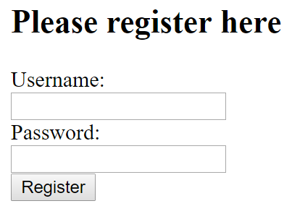
Register View
<section id="viewRegister">
<h1>Please register here</h1>
<form id="formRegister">
<div>Username:</div>
<div><input type="text" name=
"username" required /></div>
<div>Password:</div>
<div><input type="password"
name="passwd" required /></div>
<div><input type="submit" value="Register" /></div>
</form>
</section>

Slide 30
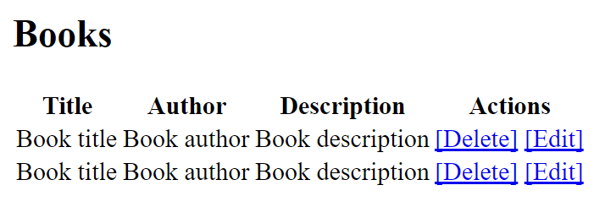
Books View
<section id="viewBooks">
<h1>Books</h1>
<div id="books">
<table>
<tr>
<th>Title</th>
<th>Author</th>
<th>Description</th>
<th>Actions</th>
</tr>
<tr>
<td>Book title</td>
<td>Book author</td>
<td>Book description</td>
<td>
<a href="#">[Delete]</a>
<a href="#">[Edit]</a>
</td>
</tr>
…
</table>
</div>
</section>

Slide 31
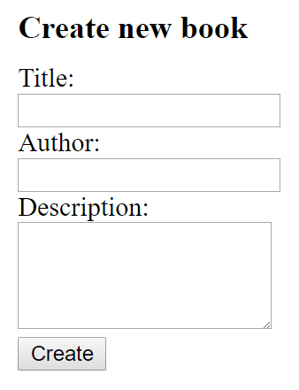
Create Book View
<section id="viewCreateBook">
<h1>Create new book</h1>
<form id="formCreateBook">
<div>Title:</div>
<div><input type="text" name="title" required /></div>
<div>Author:</div>
<div><input type="text" name="author" required /></div>
<div>Description:</div>
<div><textarea name="descr"
rows="10" required></textarea></div>
<div><input type="submit" value="Create" /></div>
</form>
</section>

Slide 32
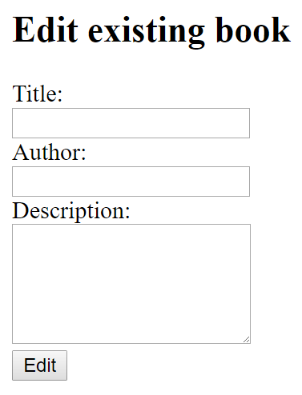
Edit Book View
<section id="viewEditBook">
<h1>Edit existing book</h1>
<form id="formEditBook">
<div><input type="hidden" name="id" required /></div>
<div>Title:</div>
<div><input type="text" name="title" required /></div>
<div>Author:</div>
<div><input type="text" name="author" required /></div>
<div>Description:</div>
<div><textarea name="descr" rows="10"
required></textarea></div>
<div><input type="submit value="Edit" /></div>
</form>
</section>

Slide 33
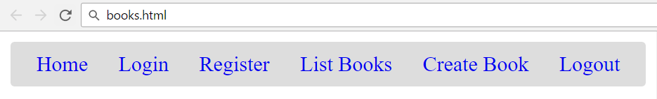
CSS: Style the Navigation Bar (Menus)
#menu {
background: #DDD;
text-align: center;
padding: 5px;
line-height: 1.5;
border-radius: 3px;
overflow: auto;
}
#menu>#loggedInUser {
float: right;
margin-right: 10px;
}
#menu a {
text-decoration: none;
padding: 5px 10px;
border-radius: 5px;
}
#menu a:hover {
background: #BBB;
}

Slide 34
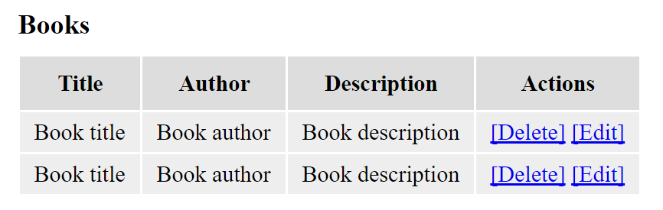
Style the Sections and Tables
main > section {
display: none;
padding: 20px 5px;
}
section h1 {
margin: 10px 0px;
font-size: 1.2em;
}
table th {
background: #DDD;
padding: 10px;
}
table td {
padding: 5px 10px;
background: #EEE;
}

Slide 35
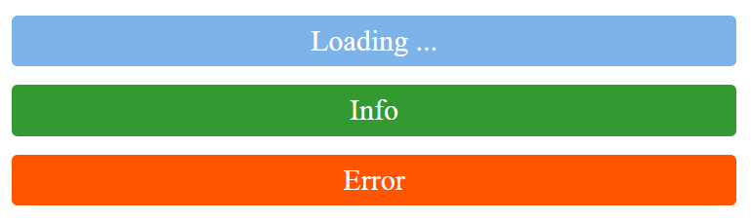
Style the Loading / Info / Error Boxes
#infoBox, #errorBox, #loadingBox {
width: 80%;
margin: 10px auto;
color: white;
text-align: center;
padding: 5px;
border-radius: 3px;
}
#loadingBox {
background: #7CB3E9;
}
#infoBox {
background: #393;
}
#errorBox {
background: #F50;
}

Slide 36

Style the App Footer
footer {
background: #DDD;
padding: 5px 10px;
font-size: 0.8em;
text-align: center;
border-radius: 3px;
}

Slide 37
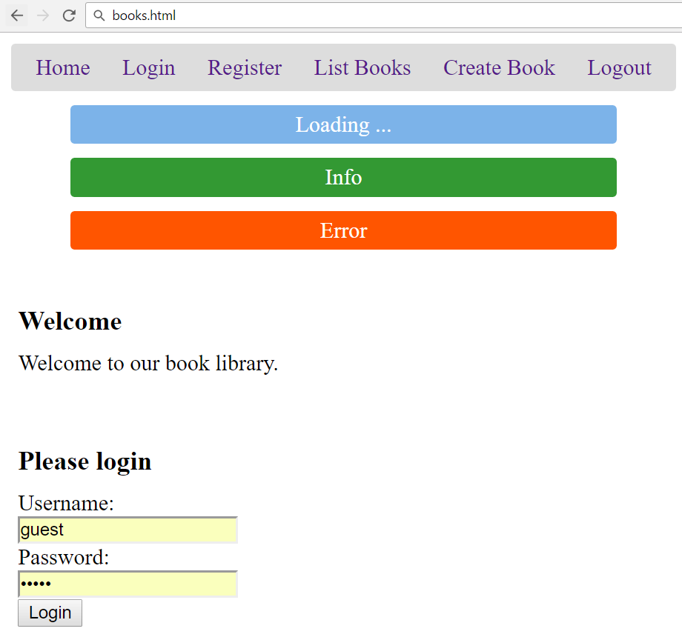
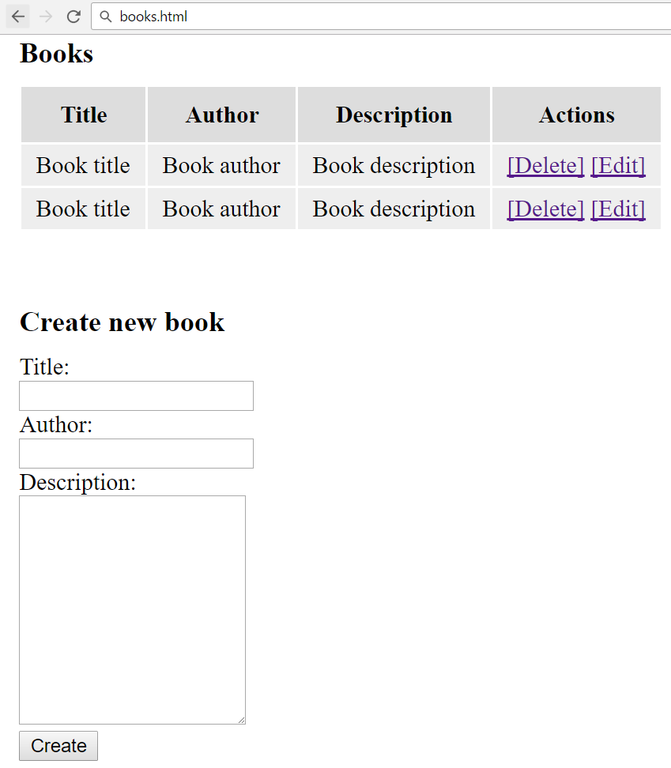
Test the App Skeleton

Slide 38
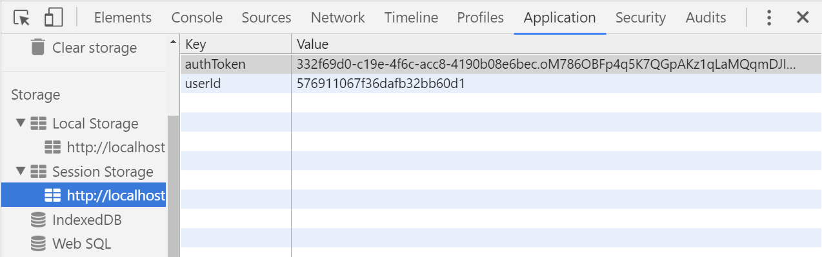




Session / Local Storage

Slide 39
Session / Local Storage – Overview
Session storage holds key / value pairs in the browser session
All data is lost when the browser is closed, survives page reloads
// Save data to sessionStorage
sessionStorage.setItem('username', 'maria');
// Get saved data from sessionStorage
let currentUser = sessionStorage.getItem('username');
// Remove all saved data from sessionStorage
sessionStorage.clear();

Slide 40
Local Storage
Local storage holds key / value pairs in the browser
Data survives for long time, until manually deleted
Each origin (site location) has its own storage
https://softuni.bg holds different data than https://google.com
// Save data to localStorage
localStorage.setItem('language', 'en');
// Get saved data from localStorage
let lang = localStorage.getItem('languuage');

Slide 41
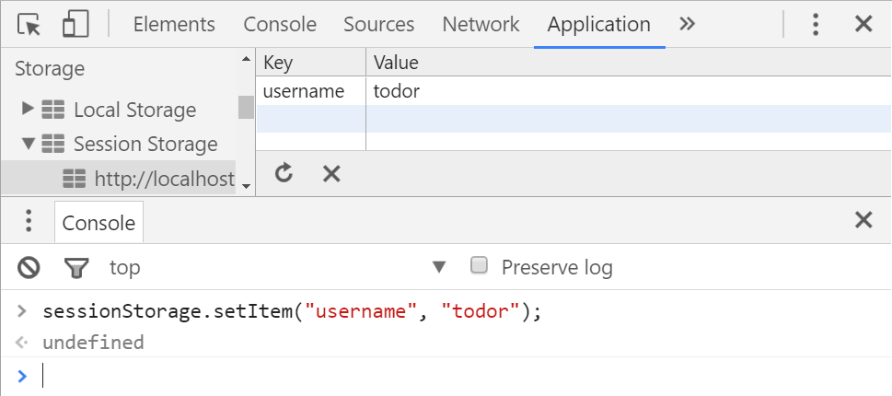
Play with the Session Storage

Slide 42
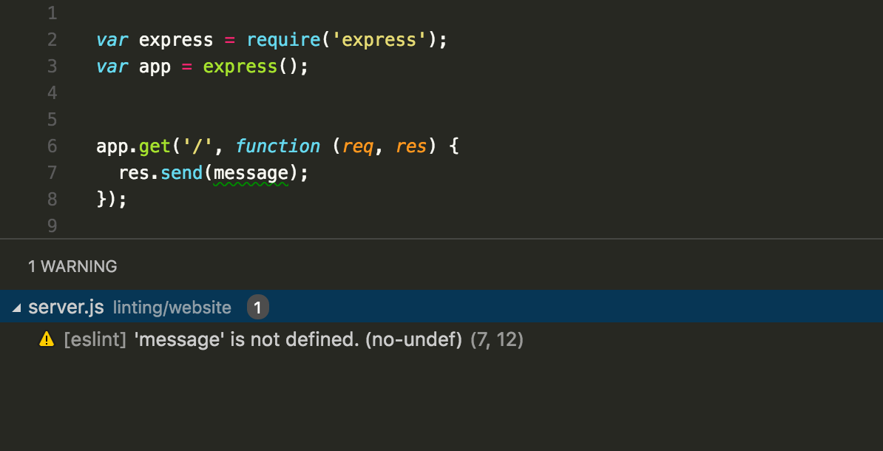


App Code Structure

Slide 43
App Structure
book-library.js
function startApp() {
sessionStorage.clear(); // Clear user auth data
showHideMenuLinks();
showView('viewHome');
// Bind the navigation menu links
$("#linkHome").click(showHomeView);
…
// Bind the form submit actions
$("#formLogin").submit(loginUser);
…
$("form").submit(function(e) { e.preventDefault() });
}
Handle form.submit() not button.click(). Otherwise validation fill be bypassed.
Disable default submit for all forms

Slide 44
Bind the Navigation Links
// Bind the navigation menu links
$("#linkHome").click(showHomeView);
$("#linkLogin").click(showLoginView);
$("#linkRegister").click(showRegisterView);
$("#linkListBooks").click(listBooks);
$("#linkCreateBook").click(showCreateBookView);
$("#linkLogout").click(logoutUser);

Slide 45
Bind the Form Submit Actions
// Bind the form submit buttons
$("#buttonLoginUser").click(loginUser);
$("#buttonRegisterUser").click(registerUser);
$("#buttonCreateBook").click(createBook);
$("#buttonEditBook").click(editBook);

Slide 46
Bind Info Boxes
// Bind the info / error boxes: hide on click
$("#infoBox, #errorBox").click(function() {
$(this).fadeOut();
});
// Attach AJAX "loading" event listener
$(document).on({
ajaxStart: function() { $("#loadingBox").show() },
ajaxStop: function() { $("#loadingBox").hide() }
});

Slide 47
Implement a Simple Navigation System
function showHideMenuLinks() {
$("#linkHome").show();
if (sessionStorage.getItem('authToken')) {
// We have logged in user
$("#linkLogin").hide();
$("#linkRegister").hide();
$("#linkListBooks").show();
$("#linkCreateBook").show();
$("#linkLogout").show();

Slide 48
Implement a Simple Navigation System (2)
} else {
// No logged in user
$("#linkLogin").show();
$("#linkRegister").show();
$("#linkListBooks").hide();
$("#linkCreateBook").hide();
$("#linkLogout").hide();
}
}

Slide 49
Implement a Simple Navigation System (3)
function showView(viewName) {
// Hide all views and show the selected view only
$('main > section').hide();
$('#' + viewName).show();
}
function showHomeView() {
showView('viewHome');
}

Slide 50
Implement a Simple Navigation System (4)
function showLoginView() {
showView('viewLogin');
$('#formLogin').trigger('reset');
}
function showRegisterView() {
$('#formRegister').trigger('reset');
showView('viewRegister');
}

Slide 51
Implement a Simple Navigation System (5)
function showCreateBookView() {
$('#formCreateBook').trigger('reset');
showView('viewCreateBook');
}
function loginUser() { // TODO }
function registerUser() { // TODO }
function logoutUser() { // TODO }

Slide 52
Implement a Simple Navigation System (6)
function listBooks() {
// TODO: to be implemented later
}
function createBook() { // TODO }
function editBook() { // TODO }
function deleteBook() { // TODO }

Slide 53
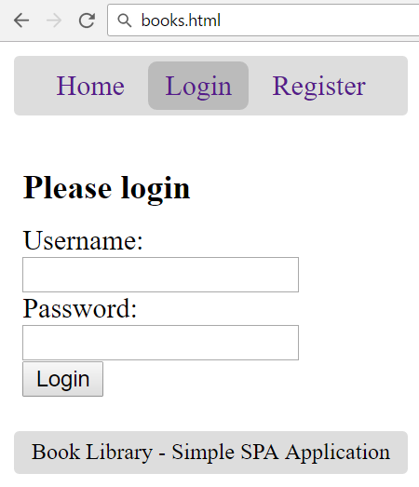
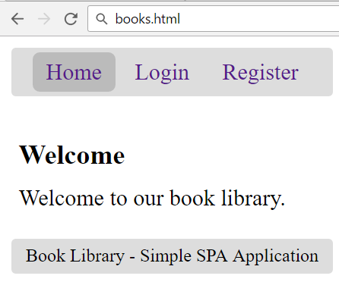
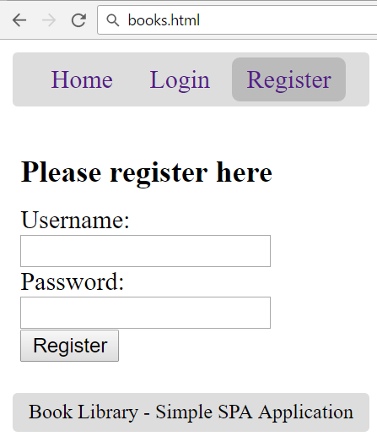
Test the App Navigation

Slide 54
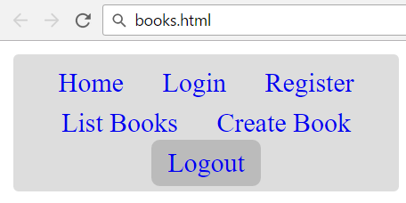
Login / Register / Logout
User Management with Kinvey

Slide 55
App Constants
const kinveyBaseUrl = "https://baas.kinvey.com/";
const kinveyAppKey = "kid_rkcLxcUr";
const kinveyAppSecret =
"e234a245b3864b2eb7ee41e19b8ca4e5";
const kinveyAppAuthHeaders = {
'Authorization': "Basic " +
btoa(kinveyAppKey + ":" + kinveyAppSecret),
};

Slide 56
User Registration: AJAX Request
function registerUser() {
let userData = {
username: $('#formRegister input[name=username]').val(),
password: $('#formRegister input[name=passwd]').val()
};
$.ajax({
method: "POST",
url: kinveyBaseUrl + "user/" + kinveyAppKey + "/",
headers: kinveyAppAuthHeaders,
data: userData,
success: registerSuccess,
error: handleAjaxError
});

Slide 57
User Registration: After AJAX Request
function registerUser() {
…
function registerSuccess(userInfo) {
saveAuthInSession(userInfo);
showHideMenuLinks();
listBooks();
showInfo('User registration successful.');
}
}

Slide 58
Remember User Authentication Data
function saveAuthInSession(userInfo) {
let userAuth = userInfo._kmd.authtoken;
sessionStorage.setItem('authToken', userAuth);
let userId = userInfo._id;
sessionStorage.setItem('userId', userId);
let username = userInfo.username;
$('#loggedInUser').text(
"Welcome, " + username + "!");
}

Slide 59
Handle AJAX Errors: Show the Error Box
function handleAjaxError(response) {
let errorMsg = JSON.stringify(response);
if (response.readyState === 0)
errorMsg = "Cannot connect due to network error.";
if (response.responseJSON &&
response.responseJSON.description)
errorMsg = response.responseJSON.description;
showError(errorMsg);
}

Slide 60
Show Info / Error Message
function showInfo(message) {
$('#infoBox').text(message);
$('#infoBox').show();
setTimeout(function() {
$('#infoBox').fadeOut();
}, 3000);
}
function showError(errorMsg) {
$('#errorBox').text("Error: " + errorMsg);
$('#errorBox').show();
}

Slide 61
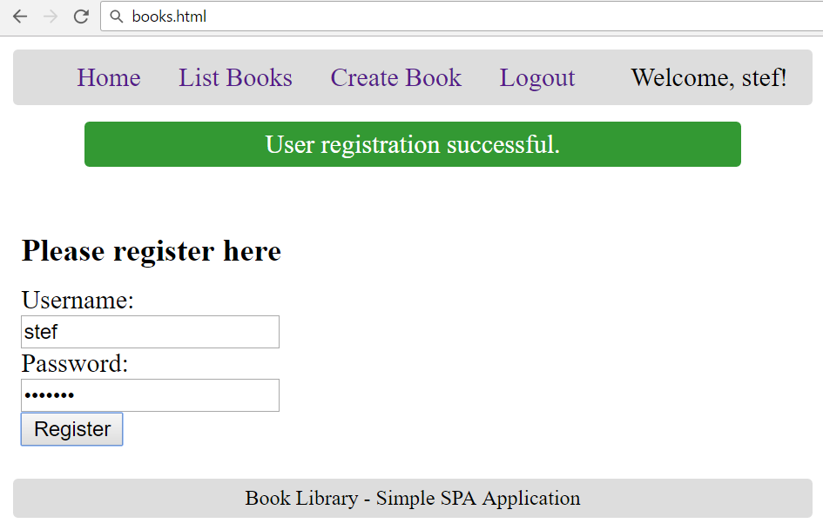
Test the User Registration: Success

Slide 62
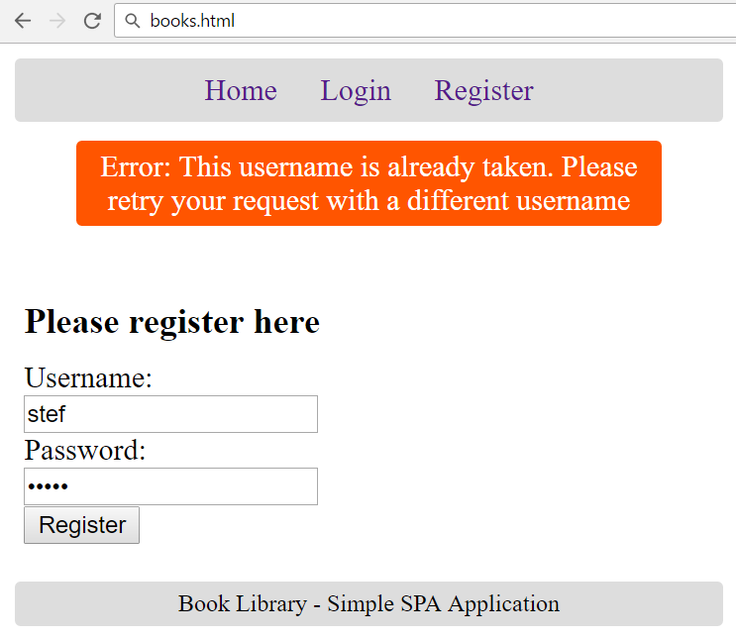
Test the User Registration: Error

Slide 63
User Login: AJAX Request
function loginUser() {
let userData = {
username: $('#formLogin input[name=username]').val(),
password: $('#formLogin input[name=passwd]').val()
};
$.ajax({
method: "POST",
url: kinveyBaseUrl + "user/" + kinveyAppKey + "/login",
headers: kinveyAppAuthHeaders,
data: userData,
success: loginSuccess,
error: handleAjaxError
});

Slide 64
User Login: After AJAX Request
function loginUser() {
…
function loginSuccess(userInfo) {
saveAuthInSession(userInfo);
showHideMenuLinks();
listBooks();
showInfo('Login successful.');
}
}

Slide 65
User Logout
function logoutUser() {
sessionStorage.clear();
$('#loggedInUser').text("");
showHideMenuLinks();
showView('viewHome');
showInfo('Logout successful.');
}

Slide 66

Implementing CRUD Operations
List / Create / Delete / Edit

Slide 67
List Books: AJAX Request
function listBooks() {
$('#books').empty();
showView('viewBooks');
$.ajax({
method: "GET",
url: kinveyBaseUrl + "appdata/" + kinveyAppKey + "/books",
headers: getKinveyUserAuthHeaders(),
success: loadBooksSuccess,
error: handleAjaxError
});
function loadBooksSuccess(books) { … }
}

Slide 68
Kinvey Authorization Headers
function getKinveyUserAuthHeaders() {
return {
'Authorization': "Kinvey " +
sessionStorage.getItem('authToken'),
};
}

Slide 69
List Books: After AJAX Request
function loadBooksSuccess(books) {
showInfo('Books loaded.');
if (books.length == 0) {
$('#books').text('No books in the library.');
} else {
let booksTable = $('<table>')
.append($('<tr>').append(
'<th>Title</th><th>Author</th>',
'<th>Description</th><th>Actions</th>'));
for (let book of books)
appendBookRow(book, booksTable);
$('#books').append(booksTable);
}
}

Slide 70
Display Single Book Line
function appendBookRow(book, booksTable) {
let links = [];
// TODO: action links will come later
booksTable.append($('<tr>').append(
$('<td>').text(book.title),
$('<td>').text(book.author),
$('<td>').text(book.description),
$('<td>').append(links)
));
}

Slide 71
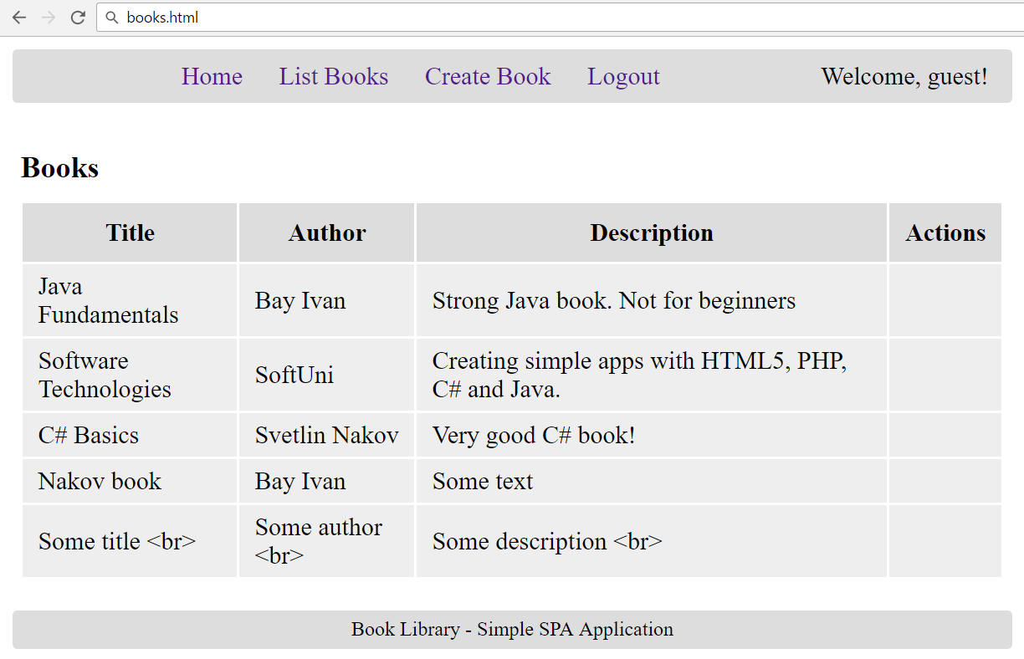
Test: List Books

Slide 72
Create New Book: AJAX Request
function createBook() {
let bookData = {
title: $('#formCreateBook input[name=title]').val(),
author: $('#formCreateBook input[name=author]').val(),
description: $('#formCreateBook textarea[name=descr]').val()
};
$.ajax({
method: "POST",
url: kinveyBaseUrl + "appdata/" + kinveyAppKey + "/books",
headers: getKinveyUserAuthHeaders(),
data: bookData,
success: createBookSuccess,
error: handleAjaxError
});

Slide 73
Create New Book: After AJAX Request
function createBookSuccess(response) {
listBooks();
showInfo('Book created.');
}
}

Slide 74
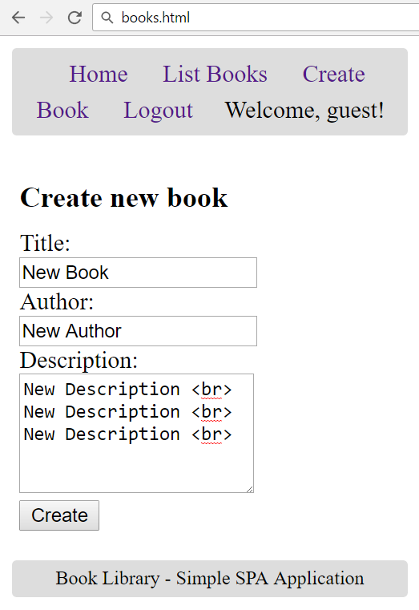
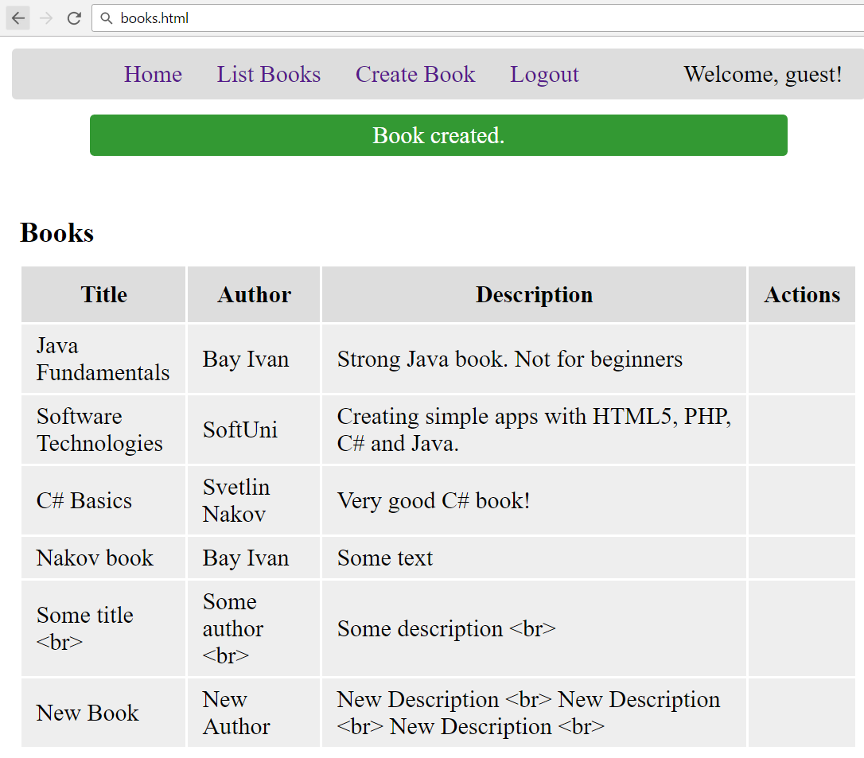
Test: Create New Book

Slide 75
Display Edit / Delete Links
function appendBookRow(book, booksTable) {
let links = [];
if (book._acl.creator == sessionStorage['userId']) {
let deleteLink = $('<a href="#">[Delete]</a>')
.click(deleteBook.bind(this, book));
let editLink = $('<a href="#">[Edit]</a>')
.click(loadBookForEdit.bind(this, book));
links = [deleteLink, ' ', editLink];
}
booksTable.append($('<tr>')
.append( … cells & links ));
}
Bind the event handler with the current book

Slide 76
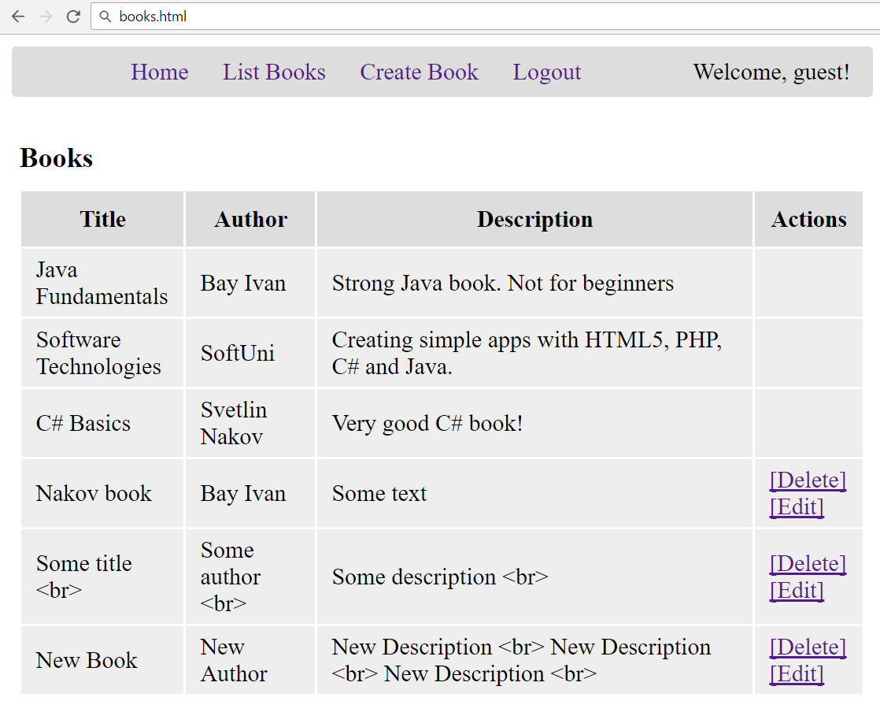
Test: Display Edit / Delete Links

Slide 77
Delete Book: AJAX Request
function deleteBook(book) {
$.ajax({
method: "DELETE",
url: kinveyBookUrl = kinveyBaseUrl + "appdata/" +
kinveyAppKey + "/books/" + book._id,
headers: getKinveyUserAuthHeaders(),
success: deleteBookSuccess,
error: handleAjaxError
});
function deleteBookSuccess(response) {
listBooks();
showInfo('Book deleted.');
}
}

Slide 78


Test: Delete Book

Slide 79
Load Book for Edit: AJAX Request
function loadBookForEdit(book) {
$.ajax({
method: "GET",
url: kinveyBookUrl = kinveyBaseUrl + "appdata/" +
kinveyAppKey + "/books/" + book._id,
headers: getKinveyUserAuthHeaders(),
success: loadBookForEditSuccess,
error: handleAjaxError
});
…

Slide 80
Load Book for Edit: After AJAX Request
function loadBookForEditSuccess(book) {
$('#formEditBook input[name=id]').val(book._id);
$('#formEditBook input[name=title]').val(book.title);
$('#formEditBook input[name=author]')
.val(book.author);
$('#formEditBook textarea[name=descr]')
.val(book.description);
showView('viewEditBook');
}
}

Slide 81
Edit Book: AJAX Request
function editBook() {
let bookData = {
title: $('#formEditBook input[name=title]').val(),
author: $('#formEditBook input[name=author]').val(),
description:
$('#formEditBook textarea[name=descr]').val()
};
$.ajax({
method: "PUT",
url: kinveyBaseUrl + "appdata/" + kinveyAppKey +
"/books/" + $('#formEditBook input[name=id]').val(),

Slide 82
Edit Book: AJAX Request (2)
headers: getKinveyUserAuthHeaders(),
data: bookData,
success: editBookSuccess,
error: handleAjaxError
});
function editBookSuccess(response) {
listBooks();
showInfo('Book edited.');
}
}

Slide 83



Test: Edit Book

Slide 84

Summary
Single Page Apps (SPA) are built with HTML5, AJAX and REST + some back-end
App navigation may consist of DOM elements, which are shown / hidden
Login / register / logout is typically implemented with sessionStorage
CRUD operations is typically send AJAX request and render the results after that
Edit / delete may require to load the item first, then edit it / confirm delete, then post changes

